Slide 1

Spotify Streams Data Analysis
Ryan Oka
R Project
8/9/25

Slide 2
Background
Data from Kaggle – Dataset of Spotify Songs updated through 2024.
Contains songs released from 1930 – 2023
Song metrics on number of playlists and charts each song appears on across different streaming platforms.
Measures/scores on audio features for each song
Kaggle Data Source
Analysis focus is on the number of streams and features on the top streamed songs.

Slide 3
Questions
What songs are most popular on Spotify?
What characteristics and attributes do these songs have?
What is the relationship of the most streamed songs to the other attributes in the data?

Slide 4
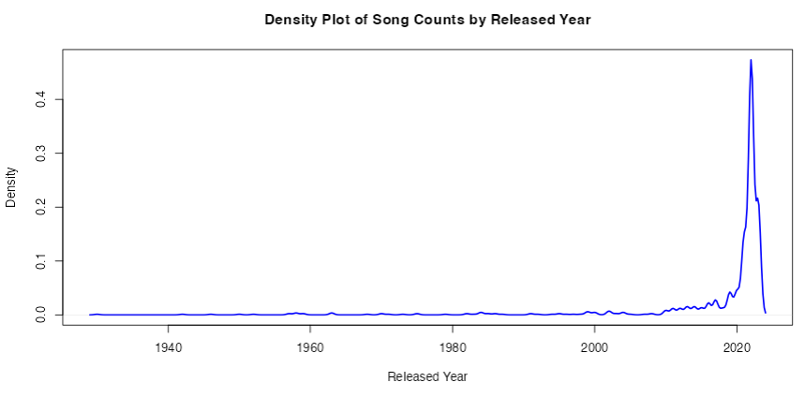
Timeline of Songs by Released Year
Majority of the songs on the platform were released after 2020.

Slide 5
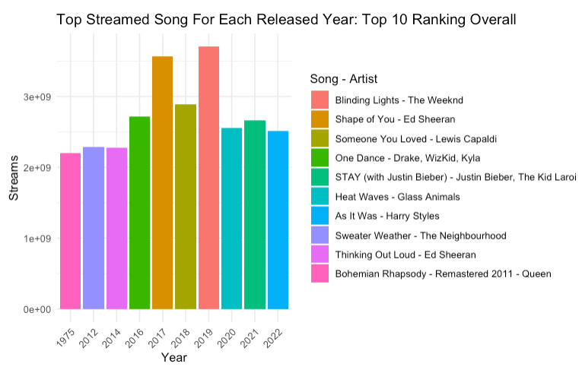
Top Streamed Song Each Year Ranked By Overall Streams
The top streamed songs came from 2017 and 2019.
Even though the list is dominated by recent years, Bohemian Rapsody - Queen from 1975 made the top 10.

Slide 6
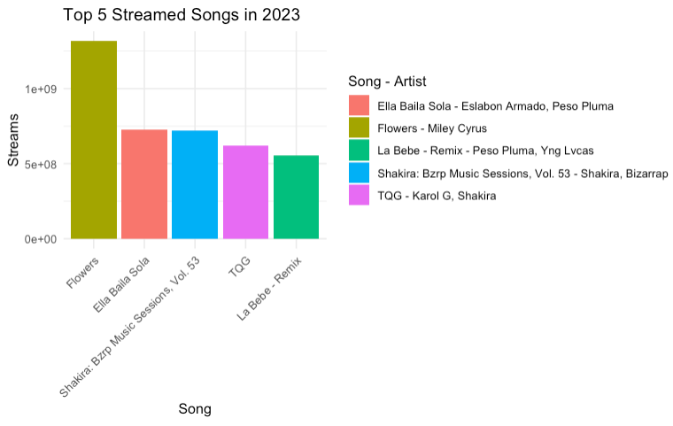
Top 5 Streamed Songs Each Year
2019 – 2023 each had a similar chart with the top streamed song dominating the rest of the top five.
Majority of other years saw a more equal distribution among the top 5.

Slide 7
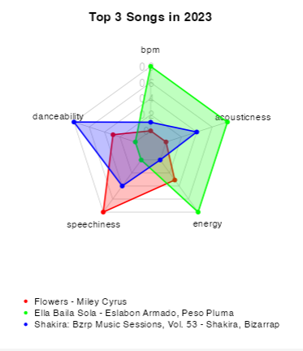
Audio Features of the Top Streamed Songs
The top 3 songs each year appear to be quite diverse in their musical features showing the variety in popular music.

Slide 8
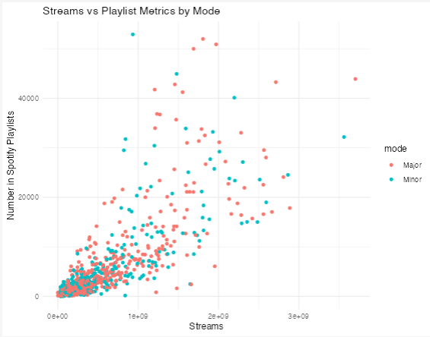
Influence of Playlist Appearances on Streams
Both major and minor modes on music appear equally represented on playlists and the number of streams.

